Slide 1


Man-machine game of TicTacToe
Liu Xinran

Slide 2

PART 01
Why I choose TicTacToe?

Slide 3
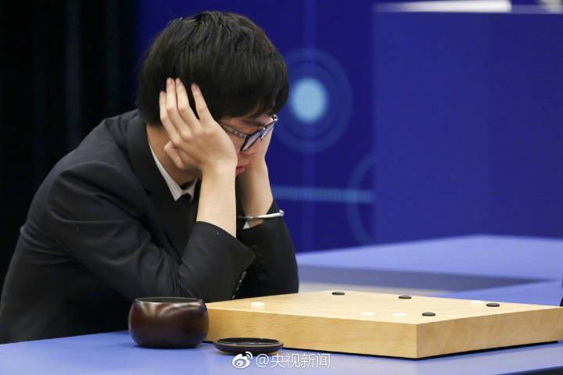
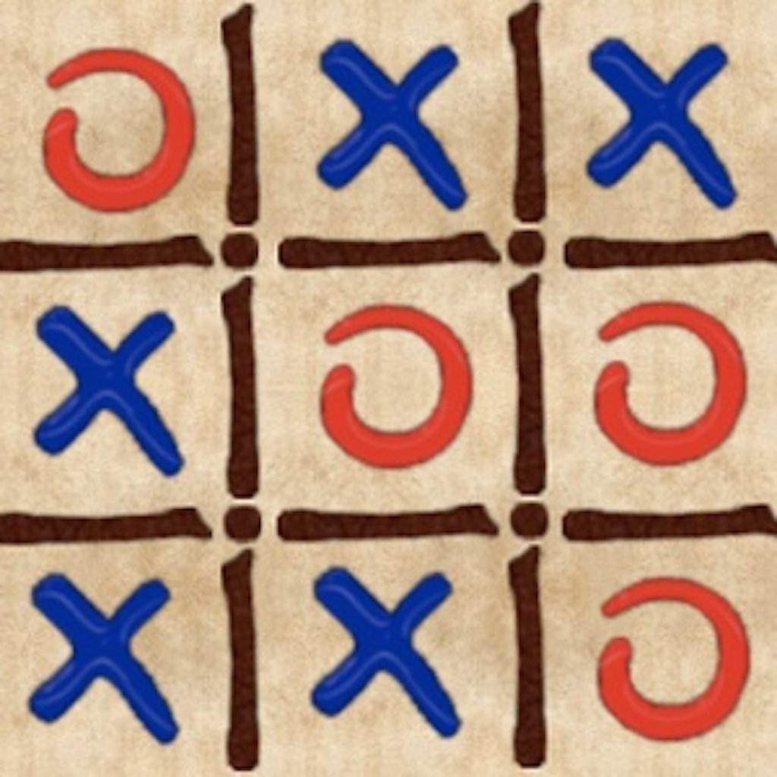
The idea came first was
five-in-a-row. But it is too complex.TicTacToe is easier to study its logic.

Slide 4
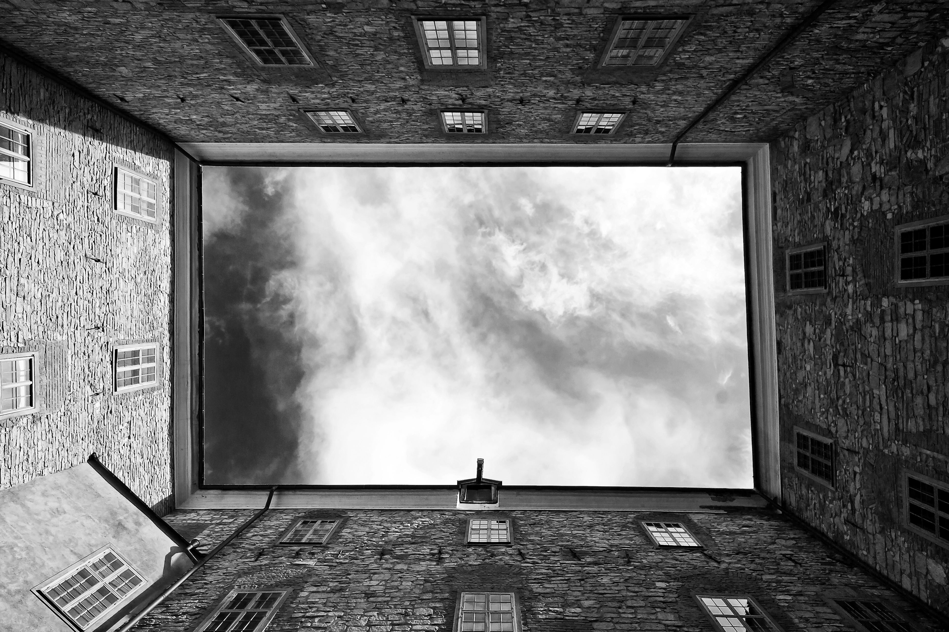
PART 02
How to make the computer play chess?

Slide 5
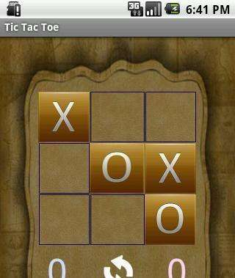
Weight
If we define the chessboard an array,the weight means the importance of each place.
The computer will choose the place that has the biggest weight to play chess.

Slide 6
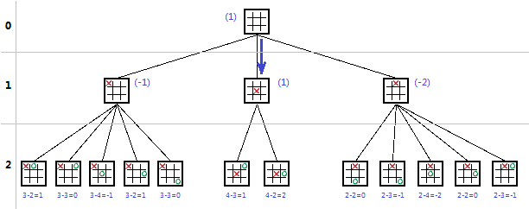
Minimax algorithm
Minemax algorithm means one side chooses the option to maximize your advantage,the other side chooses to minimize the advantage of opponent.
Please add your text description to the flying impression plane.
Please add your text description to the flying impression plane.
Please add your text description to the flying impression plane.

Slide 7

PART 03
The show of core cord

Slide 8
int get_best_chess(struct CHESS_MAN *best_chess, int player, int other)
{
int chess_value[9];
struct CHESS_MAN chess[9];
int i,j,cur=0;
for(i=0;i<SIZE;i++)
{
for(j=0;j<SIZE;j++)
{
chess[cur].row=i;
chess[cur++].col=j;
}
}
for(i=0;i<9;i++)
{
if(enter_chess_man(chess[i].row,chess[i].col,player)==TRUE)
{
chess_value[i]=get_value(other);
if(chk_winner(player)==TRUE) chess_value[i]=WINNER; chessboard[chess[i].row][chess[i].col]=NONE;
}
else chess_value[i]=COMPETITOR;
}
cur=0; for(i=0;i<9;i++)
{
if(chess_value[cur]>chess_value[i]) cur=i;
}
best_chess->row=chess[cur].row;
best_chess->col=chess[cur].col;
return chess_value[cur];
};
Value function

Slide 9
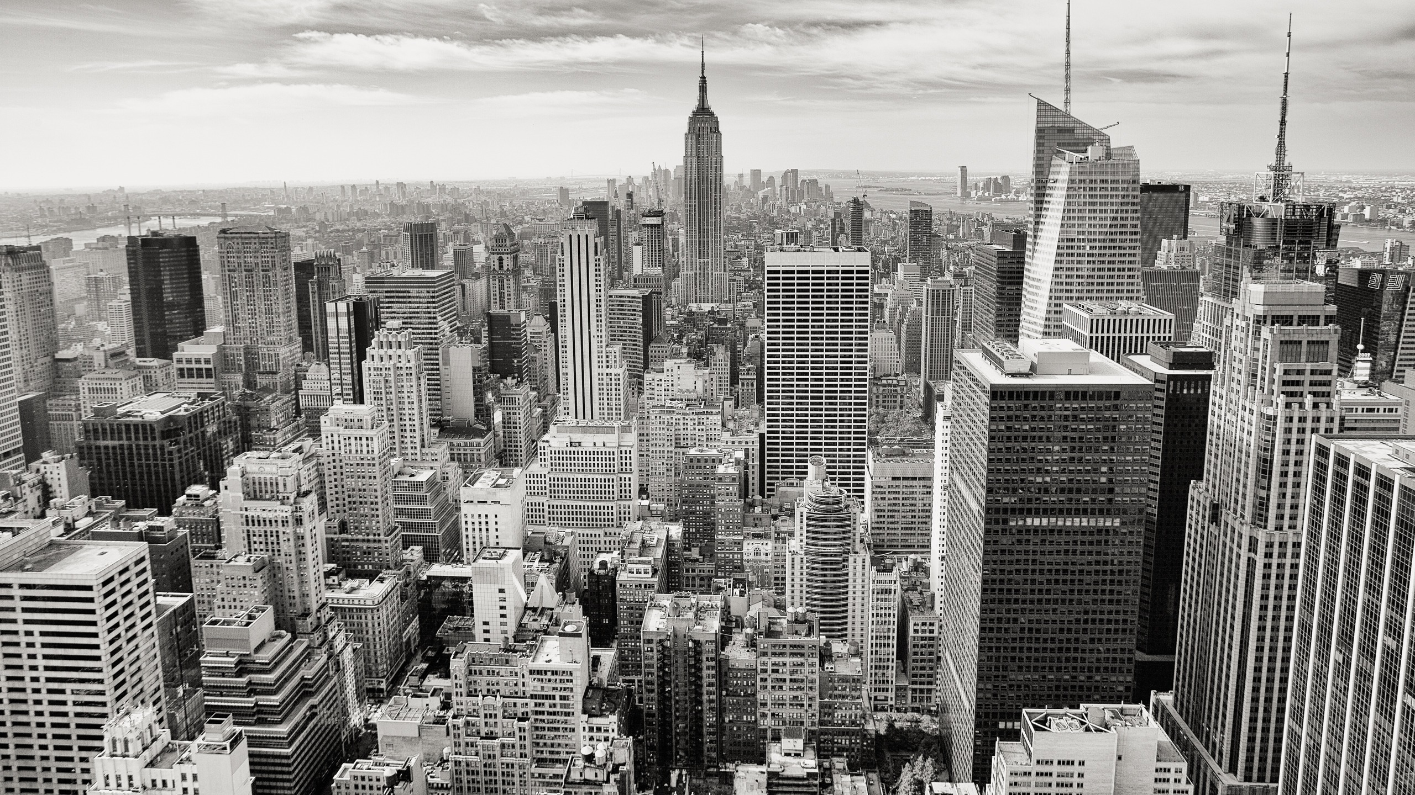
PART 04
Conclusion

Slide 10
Conclusion
This program is my first attempt to the artificial intelligence.
This algorithm can be used in more complex program.
The algorithm can be improved.Using AlphaBeta pruning algorithm can increase search efficiency.
This design makes me be skilled in write code.
I have read a book named Neural Networks and Deep learning.It gave me a lot of inspiration.

Slide 11
THANK YOU

